Slide 1
Early Colonization
Part 7
Mid Atlantic Colonies Begin

Slide 2
Brain Starter
If there was something you wanted, what are some ways you could get it?

Slide 3
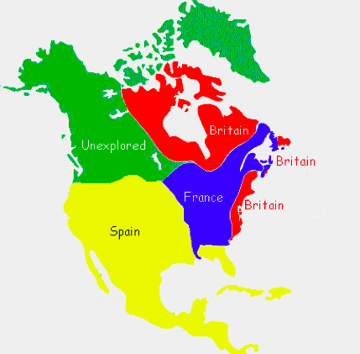
Other European countries (Spain, France, and England had already established colonies) were starting to claim land and start colonies in North America.

Slide 4
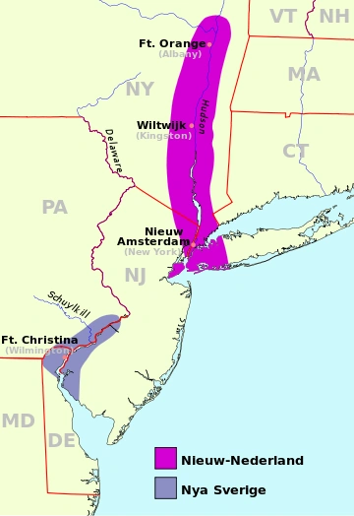
One of those countries was the Netherlands. They established a colony between New England and Virginia along the Hudson River they called New Netherland.

Slide 5
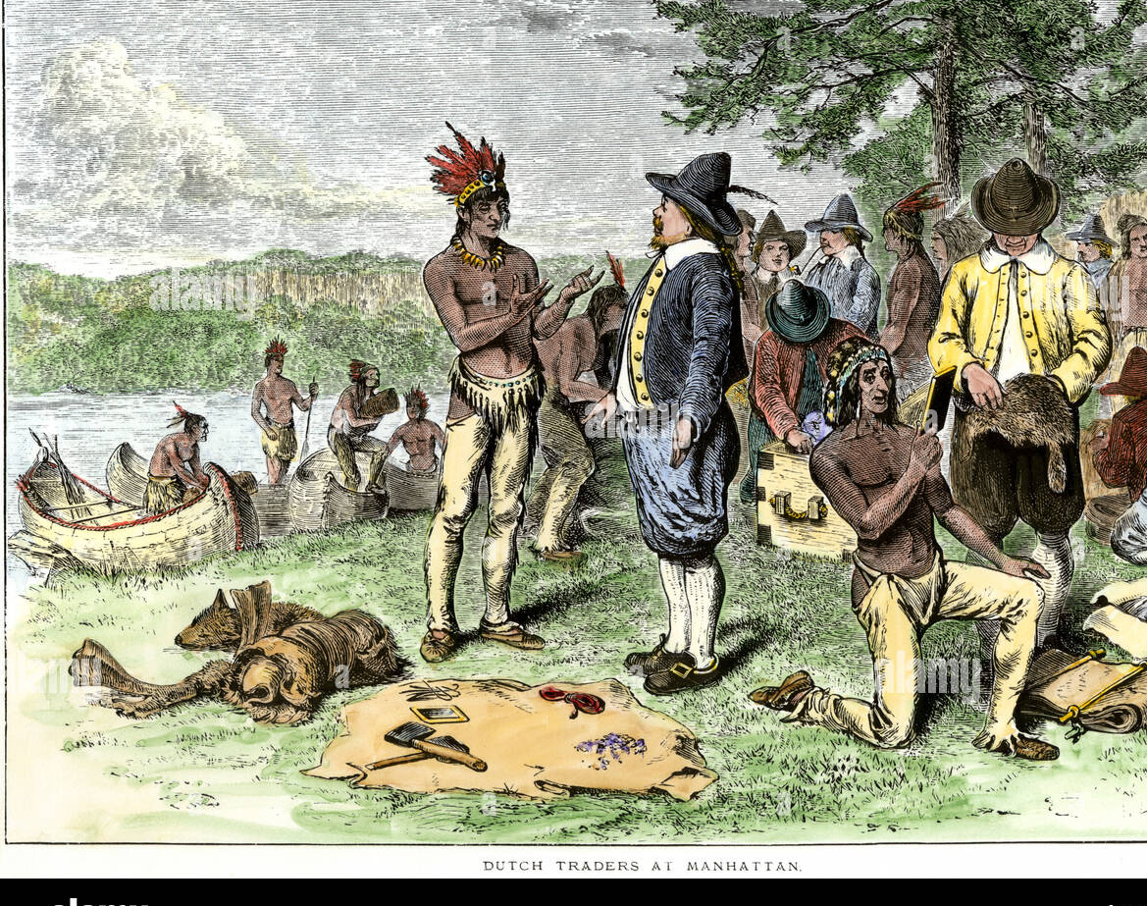
The Dutch West India Company controlled New Netherland to make a profit through the fur trade.

Slide 6
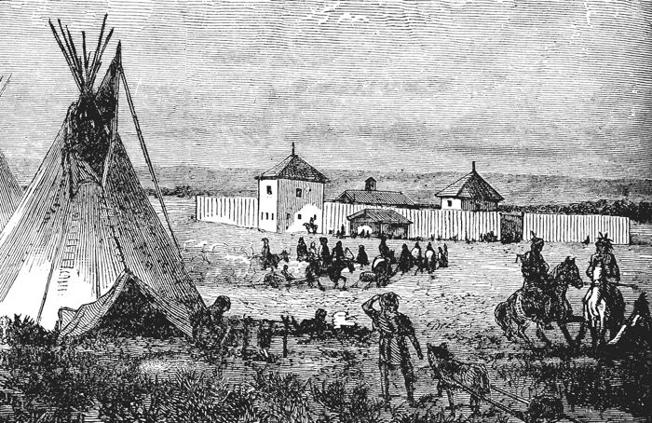
Several major cities today were started as trading posts. Albany, NY (Fort Orange),
Gloucester, NJ, (Fort Nassau), and New York City, NY (New Amsterdam) were a few in New Netherland.

Slide 7
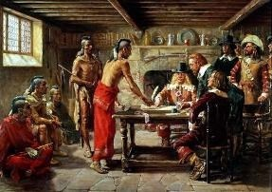
The Dutch West India Company wanted to make their claims in America more permanent, so they encouraged farming and settlement.

Slide 8
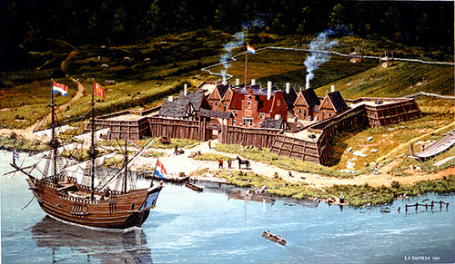
This was accomplished through patroons. A patroon was a person who brought fifty or more settlers to New Netherland. In return the patroon was given a large land grant.

Slide 9
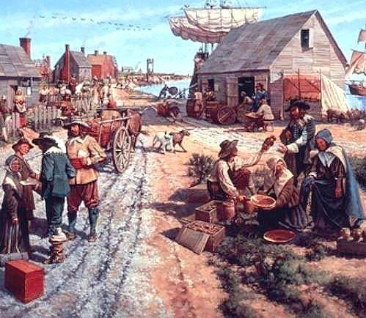
New Netherland welcomed many kinds of settlers. African indentured servants, Puritans, and Jews were among those who settled in the colony.

Slide 10
Sweden also claimed land and started a colony in America. They established New Sweden in 1638 along the southern portion of the Delaware River in what is now Delaware, New Jersey, and Pennsylvania.

Slide 11
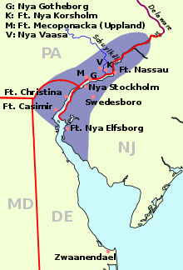
New Sweden was mainly a group of several fur-trading forts along the Delaware River.

Slide 12
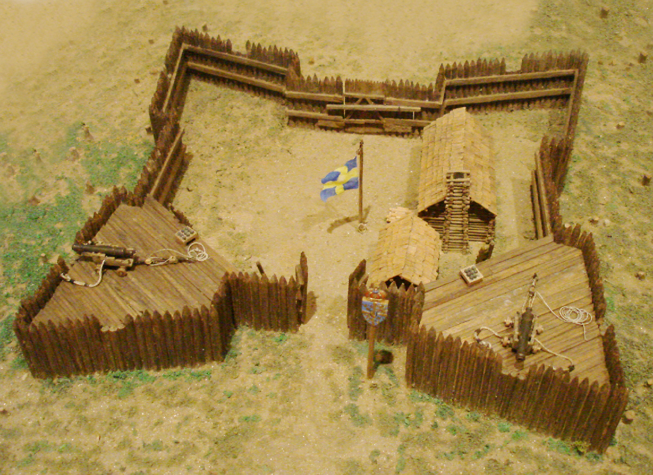
In 1655, forces from New Netherland under the control of Governor Peter Stuyvesant attacked Fort Christina (Wilmington, DE) in New Sweden and took control of the colony, making it a part of New Netherland.

Slide 13
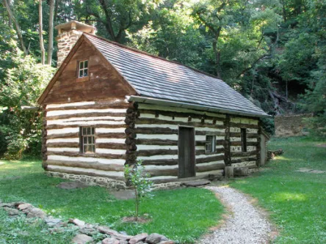
The Swedish settlers were allowed to stay as long as they followed the rules of New Netherland. Many decided to stay.

Slide 14
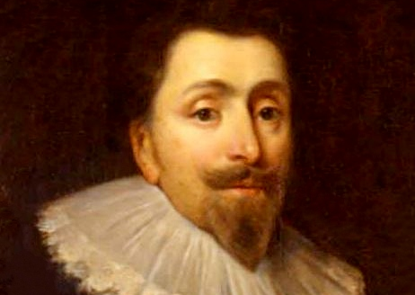
In 1634, Lord Baltimore established the colony of Maryland for England as a refuge for Catholics fleeing persecution in England.

Slide 15
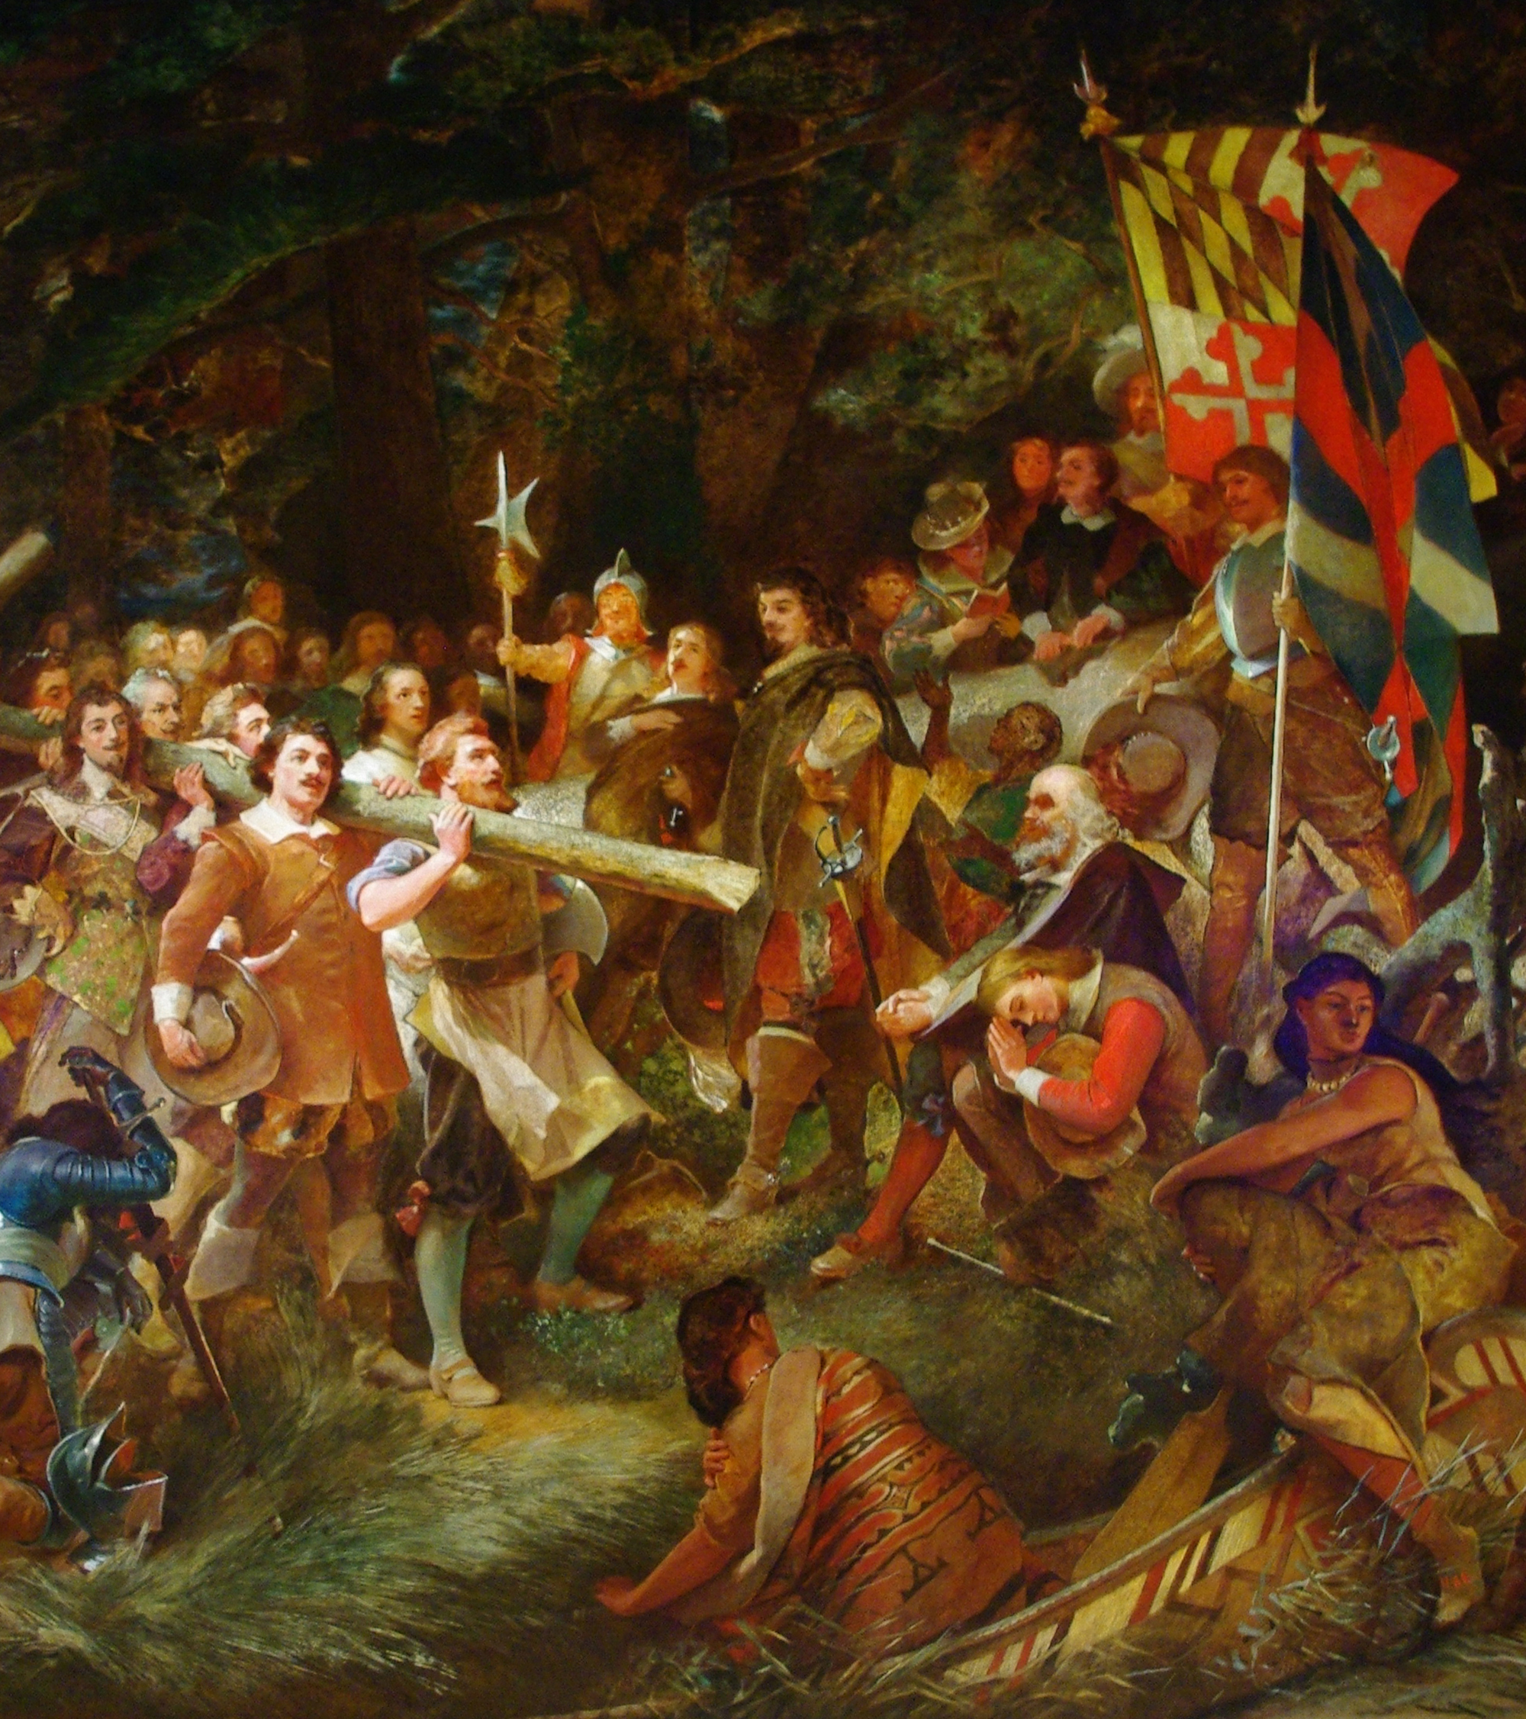
However, Lord Baltimore promised religious tolerance to Protestants and soon, due to the Great Puritan Migration, Protestants outnumbered Catholics in Maryland.

Slide 16
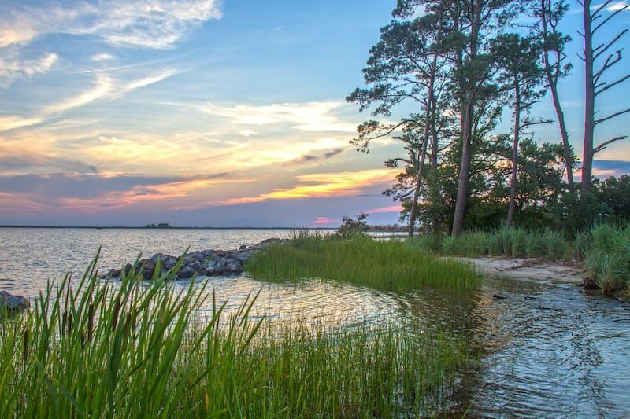
Many tobacco plantations (large farms) were started around the Chesapeake Bay in an area known as the Chesapeake Tidewater. These plantations were strung out throughout the region.

Slide 17
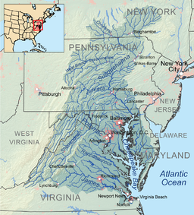
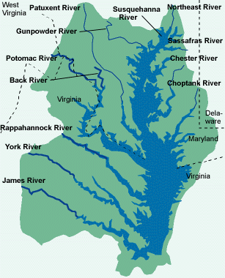

Slide 18
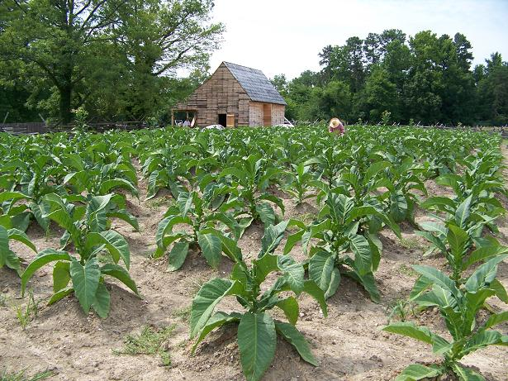
Life was very difficult for these farmers. Land had to be cleared, planting and harvesting tobacco was labor-intensive, growing tobacco used up the nutrients in the soil after a few years, and many people died from disease.

Slide 19
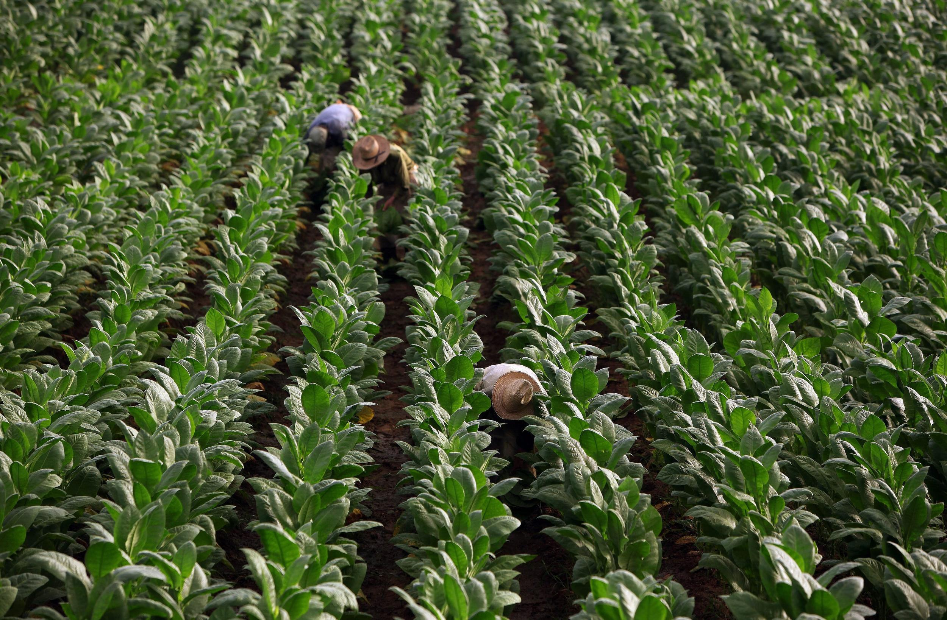
Many immigrants came to work on the tobacco farms. Some of these people were convicts sent to the colonies as punishment, some were people looking for work, but most came as indentured servants.

Slide 20
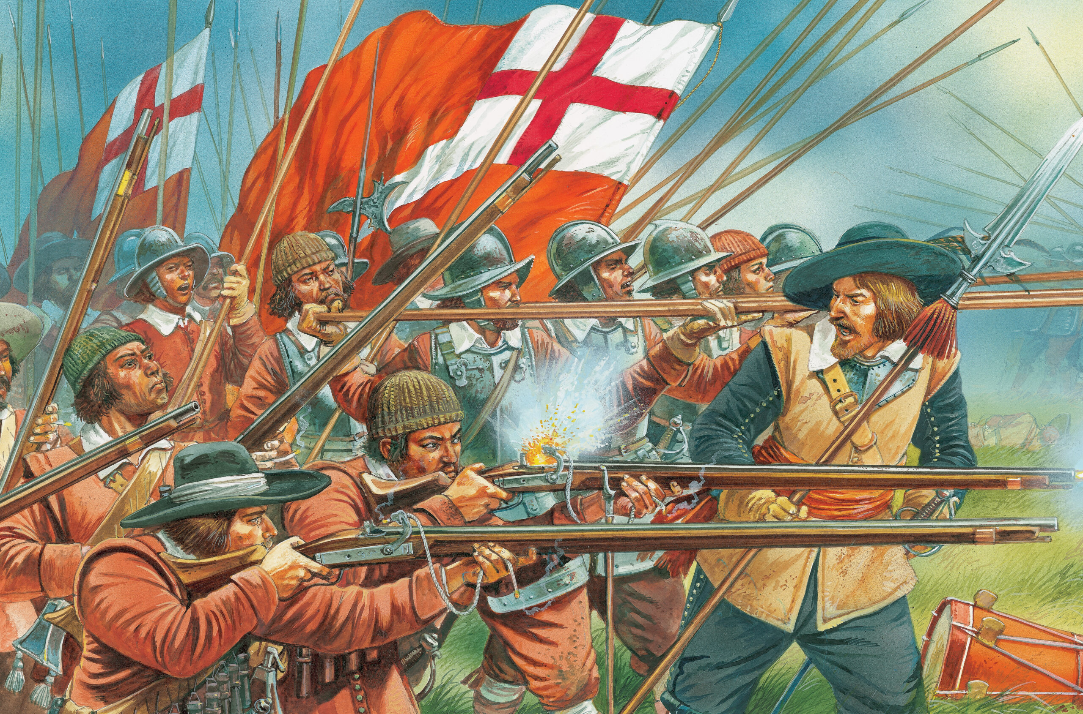
As a result of problems and a civil war in England from 1642-1660, English colonization in America stopped. In 1660, King Charles II took control in England.

Slide 21
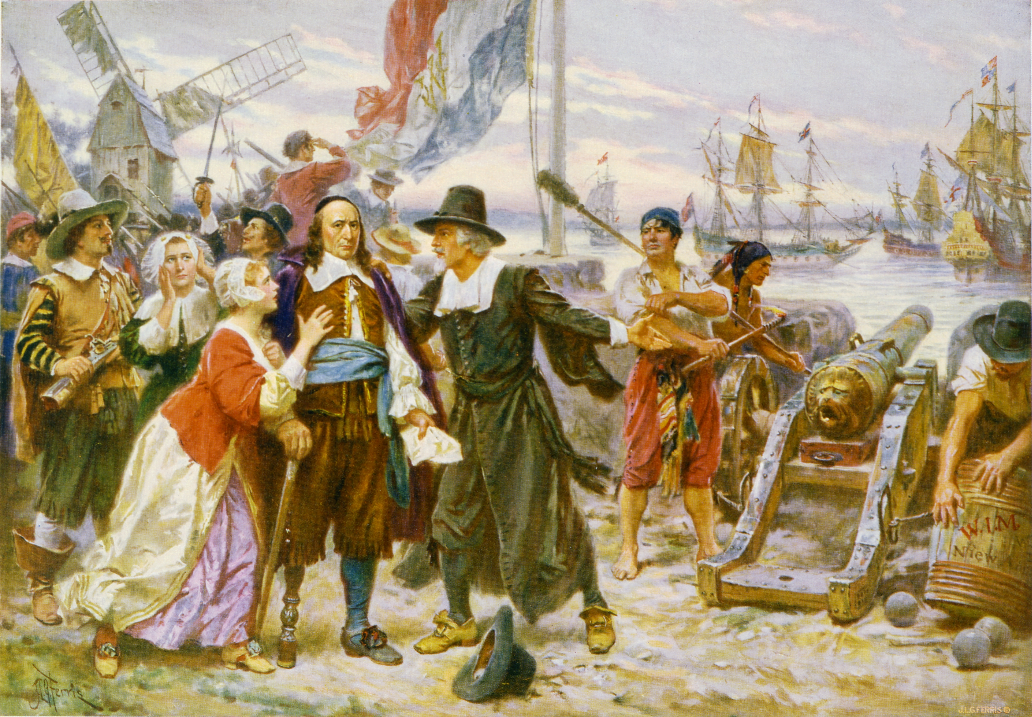
In 1664, King Charles II had his brother, the Duke of York, take over the colony of New Netherland. He became the proprietor, or owner. He renamed it New York.

Slide 22
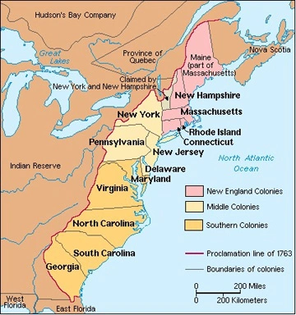
England now controlled America along the Atlantic coast from New England down to Virginia.

Slide 23
Exit Question
What are some similarities and differences we see in the formation of the Mid-Atlantic colonies compared to Virginia and the New England colonies.

